Slide 1
Computation Theory
Chapter 1
Three Basic Concepts:
Languages, Grammars, and Automata
Dr.Tarek Althami College of Science & Computer Engineering, Yanbu 2012-2013
Languages, Grammars, and Automata

Slide 2
Why study the theory of computing?
Core mathematics of CS (has not changed in over 30 years)
Many applications, especially in design of compilers and programming languages
Important to be able to recognize incomputable and intractable problems
Need to know this in order to be a computer scientist, not simply a computer programmer
Languages, Grammars, and Automata

Slide 3
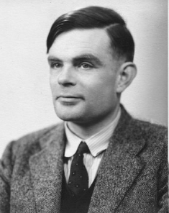
A pioneer of automata theory
Alan Turing (1912-1954)
Father of Modern Computer Science
English mathematician
Studied abstract machines called
Turing machines even before
computers existed
Languages, Grammars, and Automata

Slide 4
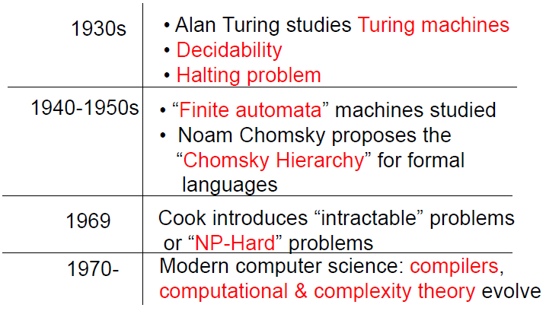
Theory of Computation: A
Historical Perspective
Languages, Grammars, and Automata

Slide 5
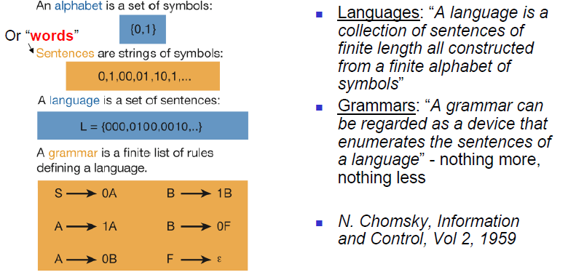
Languages & Grammars
Languages, Grammars, and Automata

Slide 6
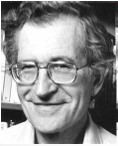
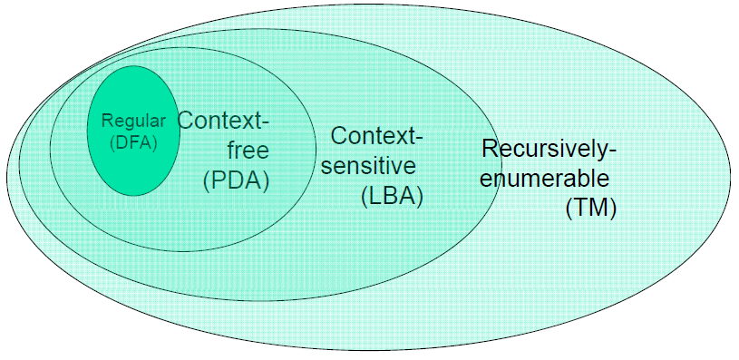
The Chomsky Hierarchy
Languages, Grammars, and Automata

Slide 7
Languages
Languages, Grammars, and Automata

Slide 8
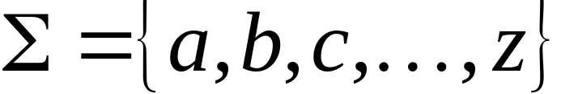
A language is a set of strings
String: A sequence of letters
  Examples: “cat”, “dog”, “house”, …
  Defined over an alphabet:
Languages, Grammars, and Automata

Slide 9

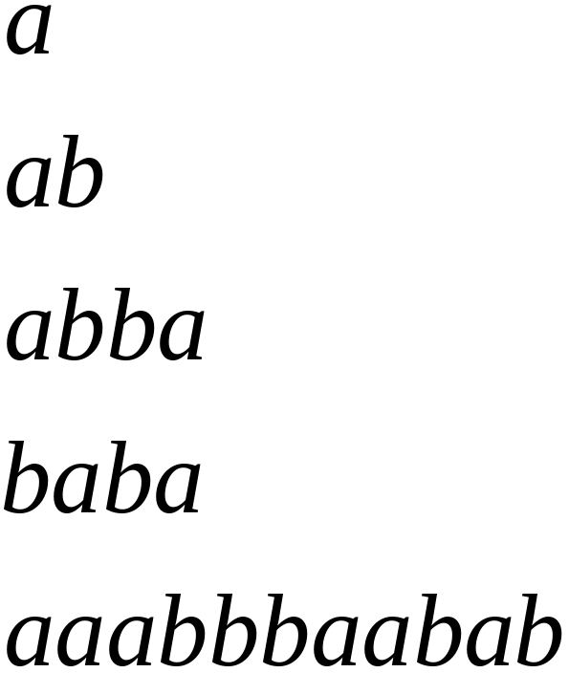
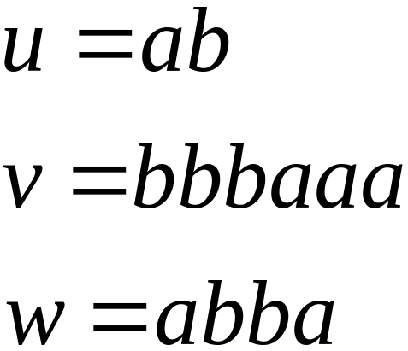
Alphabets and Strings
We will use small alphabets:
Strings
Languages, Grammars, and Automata

Slide 10
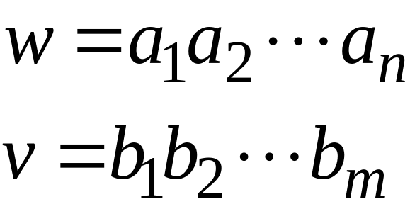
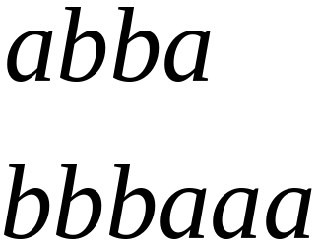
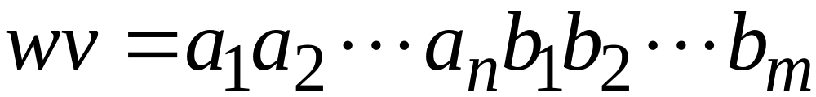

String Operations
Concatenation
Languages, Grammars, and Automata

Slide 11




Reverse
Languages, Grammars, and Automata

Slide 12


String Length
Length:
Examples:
Languages, Grammars, and Automata

Slide 13
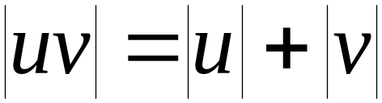

Length of Concatenation
Example:
Languages, Grammars, and Automata

Slide 14

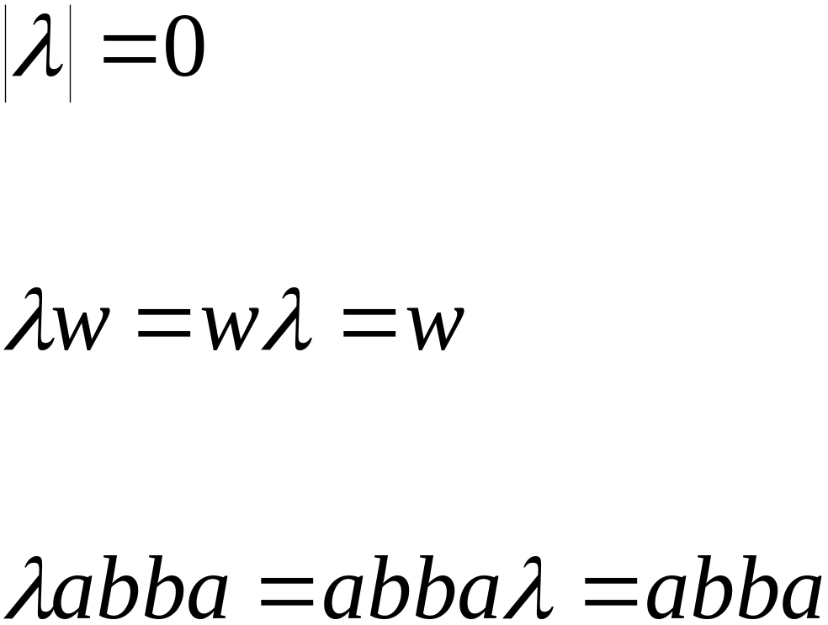
Empty String
A string with no letters:
Observations:
Languages, Grammars, and Automata

Slide 15


Substring
Substring of string:
  a subsequence of consecutive characters
String Substring
Languages, Grammars, and Automata

Slide 16




Prefix and Suffix
Prefixes Suffixes
prefix
suffix
Languages, Grammars, and Automata

Slide 17




Another Operation
Example:
Definition:
Languages, Grammars, and Automata

Slide 18



The * Operation
: the set of all possible strings from
alphabet
Languages, Grammars, and Automata

Slide 19

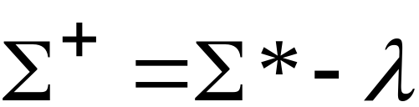
The + Operation
: the set of all possible strings from
alphabet except
Languages, Grammars, and Automata

Slide 20


Languages
A language is any subset of
Example:
Languages:
Languages, Grammars, and Automata

Slide 21
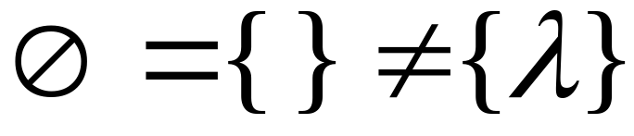



Note that:
Sets
Set size
Set size
String length
Languages, Grammars, and Automata

Slide 22




Another Example
An infinite language
Languages, Grammars, and Automata

Slide 23


Operations on Languages
The usual set operations
Complement:
Languages, Grammars, and Automata

Slide 24



Reverse
Definition:
Examples:
Languages, Grammars, and Automata

Slide 25


Concatenation
Definition:
Example:
Languages, Grammars, and Automata

Slide 26



Another Operation
Definition:
Special case:
Languages, Grammars, and Automata

Slide 27



More Examples
Languages, Grammars, and Automata

Slide 28


Star-Closure (Kleene *)
Definition:
Example:
Languages, Grammars, and Automata

Slide 29
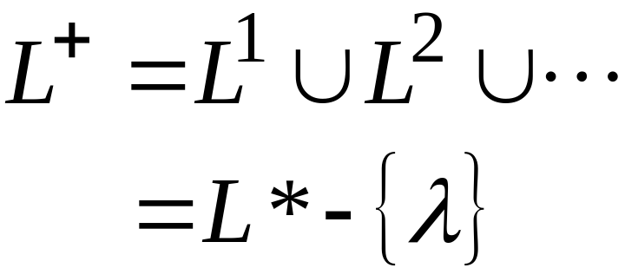

Positive Closure
Definition:
Languages, Grammars, and Automata

Slide 30
Grammars
Languages, Grammars, and Automata

Slide 31
Grammars
A grammar G is defined as a 4-tuples:
G = (V, T, S, P)
Where:
V : is a finite set of objects called variables (non terminals)
T : is a finite set of objects called terminal symbols
S : S ∈ V is a special symbol called the Start symbol
P : is a finite set of productions or "production rules"
Sets V and T are nonempty and disjoint
Languages, Grammars, and Automata

Slide 32
Grammars
Production rules have the form:
x → y
where x is an element of (V ∪ T)⁺ and y is in (V ∪ T)*
Given a string of the form
w = uxv
and a production rule
x → y
we can apply the rule, replacing x with y, giving
z = uyv
We can then say that
w ⇒ z
Read as "w derives z", or "z is derived from w"
Languages, Grammars, and Automata

Slide 33
Grammars
If u ⇒ v, v ⇒ w, w ⇒ x, x ⇒ y, and y ⇒ z, then we say:
*
u ⇒ z
This says that u derives z in an unspecified number of steps.
Along the way, we may generate strings which contain variables as well as terminals. These are called sentential forms.
Languages, Grammars, and Automata

Slide 34
Grammars
What is the relationship between a language and a grammar?
Let G = (V, T, S, P)
The set
*
L(G) = {w ∈ T* : S ⇒ w}
is the language generated by G.
Languages, Grammars, and Automata

Slide 35
Grammars
Consider the grammar G = (V, T, S, P), where:
V = {S}
T = {a, b}
S = S,
P =
S → aSb
S → λ
Languages, Grammars, and Automata

Slide 36
Grammars
What are some of the strings in this language?
S ⇒ aSb ⇒ ab
S ⇒ aSb ⇒ aaSbb ⇒ aabb
S ⇒ aSb ⇒ aaSbb ⇒ aaaSbbb ⇒ aaabbb
It is easy to see that the language generated by this grammar is:
L(G) = {a^{n}b^{n} : n ≥ 0}
Languages, Grammars, and Automata

Slide 37
Grammars
Let's go the other way, from a description of a language to a grammar that generates it. Find a grammar that generates:
L = {a^{n}b^{n+1} : n ≥ 0}
So the strings of this language will be:
b (0 a's and 1 b)
abb (1 a and 2 b's)
aabbb (2 a's and 3 b's) . . .
In order to generate a string with no a's and 1 b, you might want to write rules for the grammar that say:
S → ab
a → λ
But you can't do this; a is a terminal, and you can't change a terminal, only variables
Languages, Grammars, and Automata

Slide 38
Grammars
So, instead of:
S → ab
a → λ
we create another variable, A (we often use capital letters to stand for variables), to use in place of the terminal, a:
S → Ab
A → λ
Now you might think that we can use another S rule here to generate the other part of the string, the a^{n}b^{n} part
S → aSb
But you can't, because that will generate ab, aabb, etc.
Note, however, that if we use A in place of S, that will solve our problem:
A → aAb
Languages, Grammars, and Automata

Slide 39
Grammars
So, here are our rules:
S → Ab
A → aAb
A → λ
The S → Ab rule creates a single b terminal on the right, preceded by other strings (including possibly the empty string) on the left.
The A → λ rule allows the single b string to be generated.
The A → aAb rule and the A → λ rule allows ab, aabb, aaabbb, etc. to be generated on the left side of the string.
Languages, Grammars, and Automata

Slide 40
Finite Automata
Languages, Grammars, and Automata

Slide 41
Finite Automaton
Input
String
Output
Finite
Automaton
String
Languages, Grammars, and Automata

Slide 42
Finite Accepter
Input
String
Output
“Accept”
or
“Reject”
Finite
Automaton
Languages, Grammars, and Automata

Slide 43









Transition Graph
Abba -Finite Accepter
initial
state
final
state
“accept”
transition
state
Languages, Grammars, and Automata

Slide 44
Initial Configuration
Input String
Languages, Grammars, and Automata

Slide 45
Input finished
Output: “accept”
Languages, Grammars, and Automata

Slide 46
Ex2: Rejection
Languages, Grammars, and Automata

Slide 47
Input finished
Output:
“reject”
Languages, Grammars, and Automata

Slide 48

Ex 3 : Another Rejection
Languages, Grammars, and Automata

Slide 49
Output:
“reject”
Languages, Grammars, and Automata

Slide 50
Another Example
Languages, Grammars, and Automata

Slide 51
Input finished
Output: “accept”
Languages, Grammars, and Automata

Slide 52
Rejection
Languages, Grammars, and Automata

Slide 53
Input finished
Output: “reject”
Languages, Grammars, and Automata

Slide 54
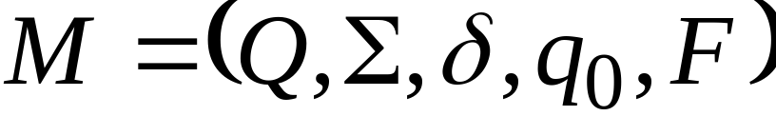




Formalities
Deterministic Finite Accepter (DFA)
: set of states
: input alphabet
: transition function
: initial state
: set of final states
Languages, Grammars, and Automata

Slide 55
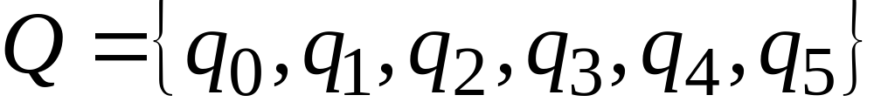
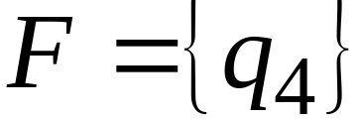
Input Alphabet:
Set of States:
Initial State: q₀
Set of Final States :
Languages, Grammars, and Automata

Slide 56


Transition Function
Languages, Grammars, and Automata

Slide 57

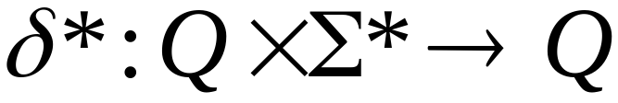
Extended Transition Function
Languages, Grammars, and Automata

Slide 58
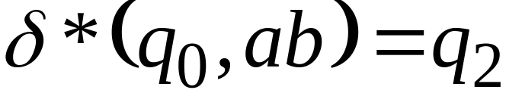
Languages, Grammars, and Automata

Slide 59
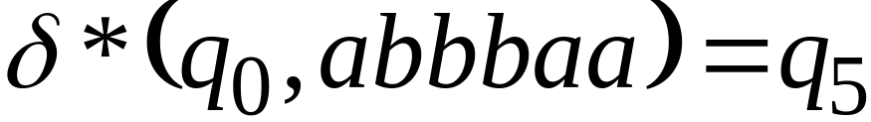
Languages, Grammars, and Automata

Slide 60



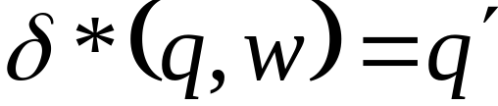

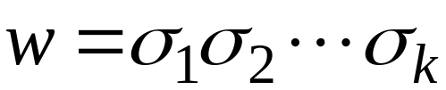



Observation: There is a walk from to
with label
Languages, Grammars, and Automata

Slide 61

Example: There is a walk from to
with label
Languages, Grammars, and Automata

Slide 62
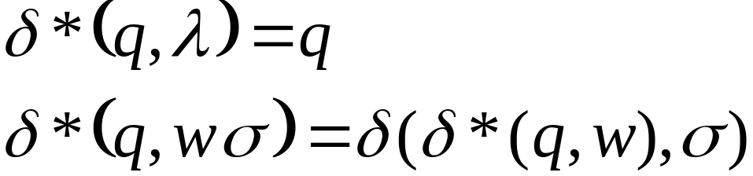


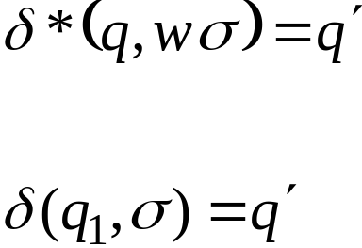
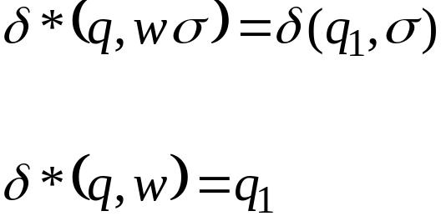

Recursive Definition
Languages, Grammars, and Automata

Slide 63
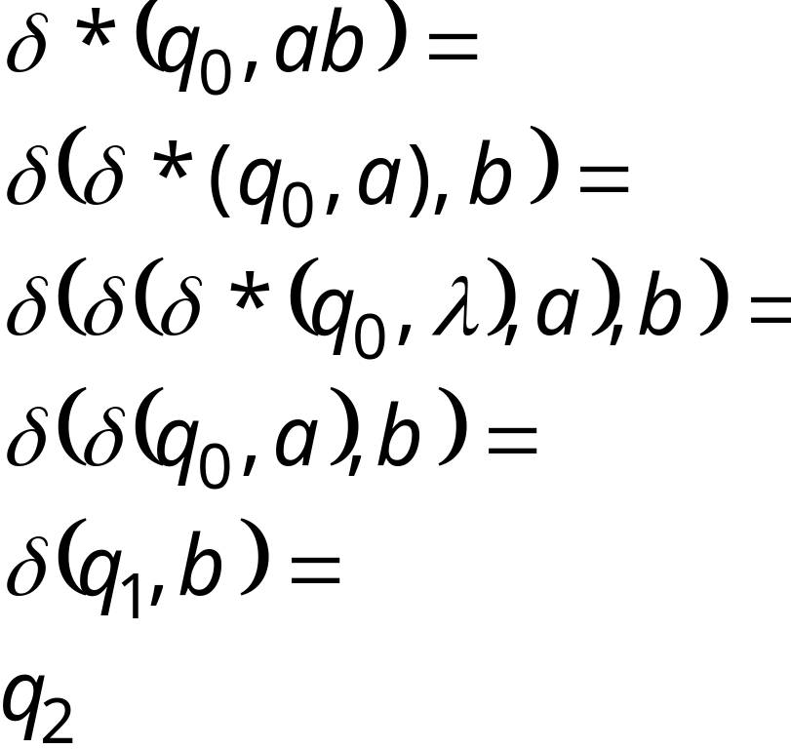
Languages, Grammars, and Automata

Slide 64

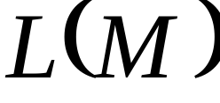

Languages Accepted by DFAs
Take DFA
Definition:
  The language contains
  all input strings accepted by
  = { strings that drive to a final state}
Languages, Grammars, and Automata

Slide 65
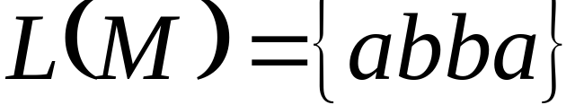
Example
accept
Languages, Grammars, and Automata

Slide 66
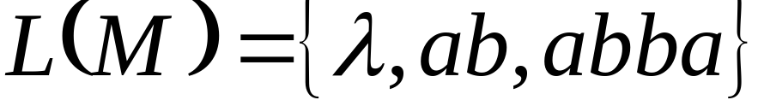
Another Example
accept
accept
accept
Languages, Grammars, and Automata

Slide 67


Formally
For a DFA
Language accepted by :
Languages, Grammars, and Automata

Slide 68

Observation
Language rejected by :
Languages, Grammars, and Automata

Slide 69
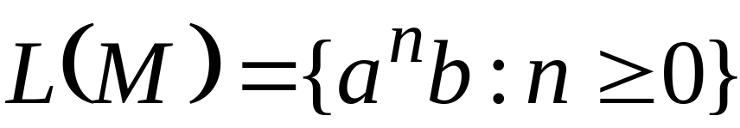
Example 1
accept
trap state
Languages, Grammars, and Automata

Slide 70

Example 2
= { all strings with prefix }
accept
Languages, Grammars, and Automata

Slide 71






Example 3
= { all strings without
substring }
Languages, Grammars, and Automata

Slide 72

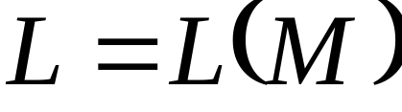
Regular Languages
A language is regular if there is
a DFA such that
All regular languages form a language family
Languages, Grammars, and Automata

Slide 73
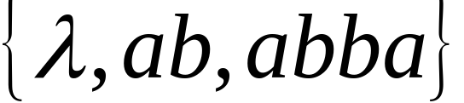
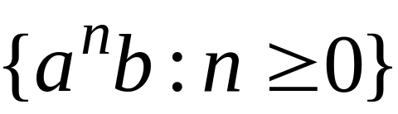
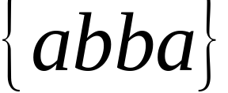
Examples of regular languages:
{ all strings with prefix }
{ all strings without substring }
There exist automata that accept these
Languages (see previous slides).
Languages, Grammars, and Automata

Slide 74
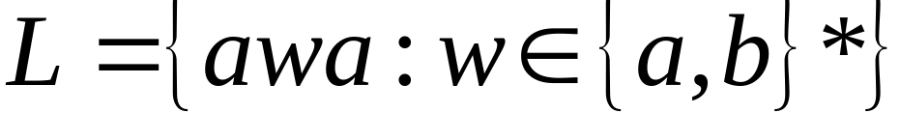
Another Example
The language
is regular:
Languages, Grammars, and Automata

Slide 75
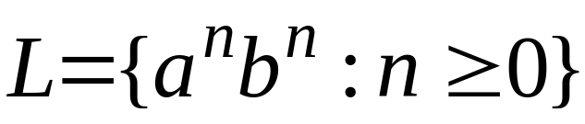
There exist languages which are not Regular:
Example:
There is no DFA that accepts such a language
(we will prove this later in the class)
Languages, Grammars, and Automata

Slide 76
Any Questions
Languages, Grammars, and Automata

